Slide 1
Scoring an alignment with substitution matrices
Generating an alignment with dynamic programming
Local alignments
Makrov Chains

Slide 2
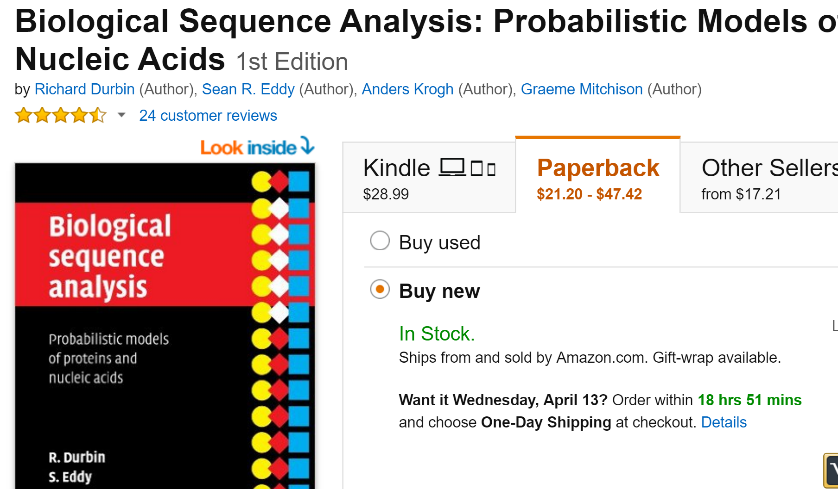
Here we follow the Durbin et al. book…

Slide 3
pairwise alignment algorithms
Given two sequences: EVLISPISHERE ELVIRAISHERE
find the best alignment:
EVLISPISHERE
ELVIRAISHERE
First we define what we mean by best alignment
From this we will define a substitution matrix

Slide 4
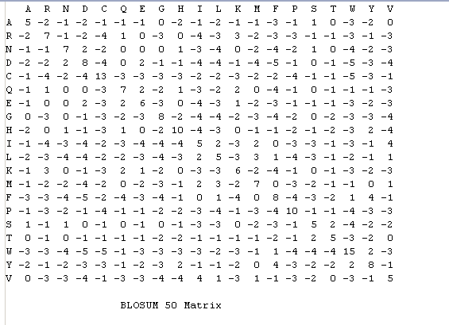
A substitution matrix is used to score how likely two residues are found in a multiple
sequence alignment
Here is the BLOSSUM 50 Matrix
https://github.com/afodor/afodor.github.io/blob/master/classes/prog2015/Blosum50.txt

Slide 5
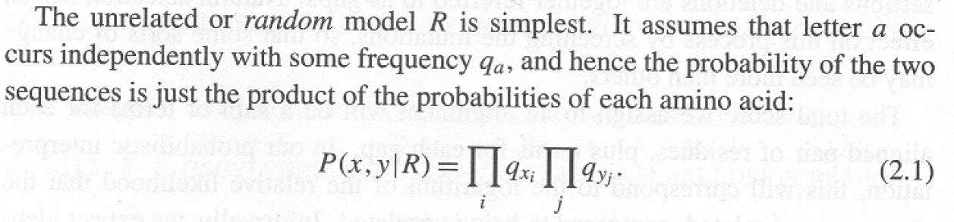
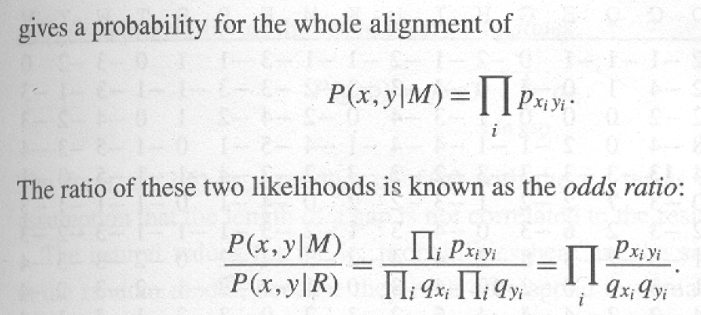
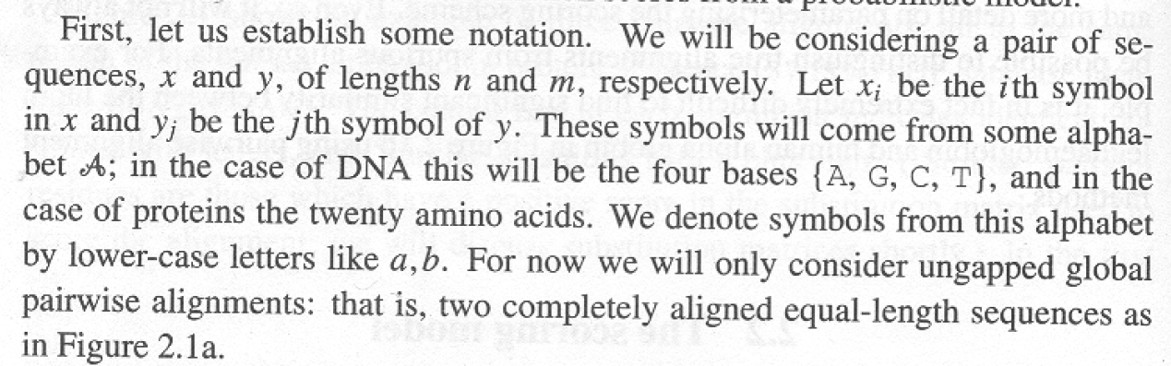
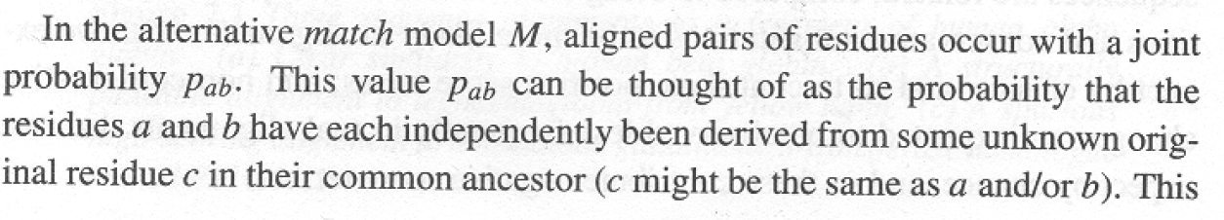
This, it turns out is the formula for scoring our alignment
Consider the case of an
ungapped global alignment
For each pair or residues in each column, what is the
probability we would observe
those residues by chance?
For each pair of residues in
each column, what is the
probability we observe those residues
because of a common ancestor?
Durbin et al Biological Sequence Analysis: Probabilistic Models of Proteins and Nucleic Acids

Slide 6
For each pair of residues in the alignment,
This is the value of the substitution matrix
(or will be once we log it)
This is the score for the whole alignment
EVLISPISHERE
ELVIRAISHERE
Here x=E, y=E
Here x=R, y=S

Slide 7
Let’s define p(sequence|random model).
Given a particular die, what is the probability of observing a sequence…
For DNA, if we have a fair die:
p(A) = p(C) = p(G) = p(T) = 0.25
Then the p(“A”,”C”| “fair die model” ) =
The probability we would observe and A and a C =
0.25 * 0.25 = 0.0625
For proteins, if we have a fair die.
p(A) = p(C) = p(D) …. p(Y) = 0.05
Then the p(“A”,”Y” | “fair die model” ) =
0.05 * 0.05 = 0.0025

Slide 8
But we can make more realistic models.
Instead of a “fair” die, consider a die that has the same frequencies as all
amino acids in a protein.

Slide 9
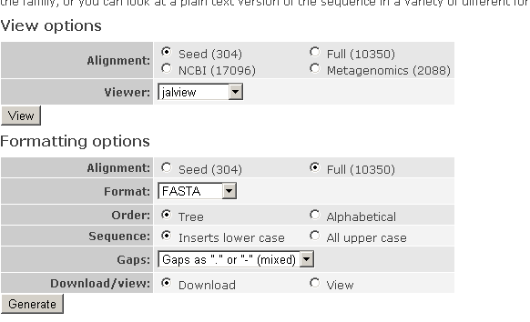
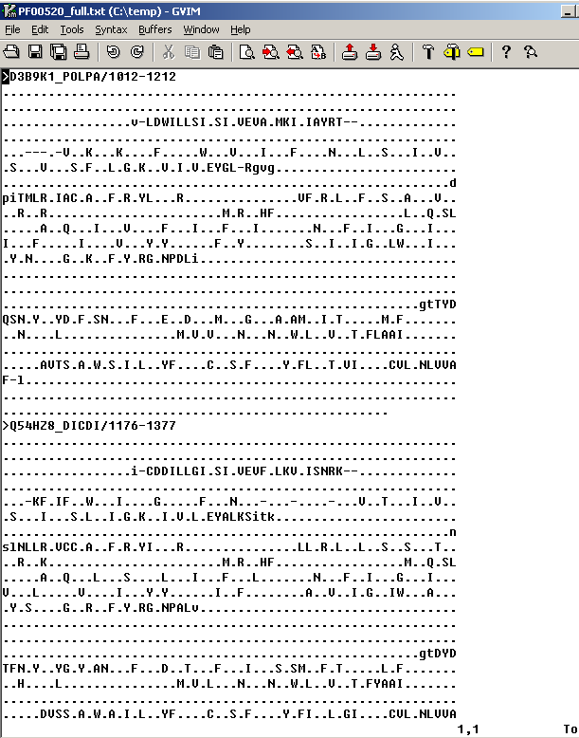
Grab some random (ion channel pore) protein alignment off the web…

Slide 10
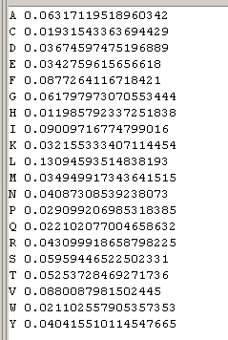
Our random model:
A 20-sided die that “rolls” an Alanine ~6% of the time
a Cys ~1.9% of the time
and so forth
(since Alanine is ~6% of the residues, Cys is ~1.9% and so forth)
q_{A}
q_{C}
The p(sequence|Random model) =
the product of all the dice rolls…
q_{D}

Slide 11
It is very unlikely that you will pick up a “protein” die and roll the entire alignment!
To get the probability of
our sequence under a
random model, we
multiply all the probabilities
together

Slide 12
What about the Match model?

Slide 13
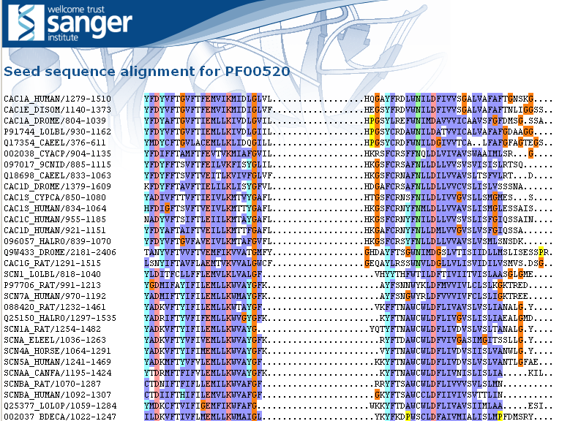
Let’s calculate p(x,y|M) naively
We’ll define p(x,y|M) as the frequency of seeing a pair of residues aligned against each other from the first 200 pfam families…
Considering all pairwise sequences in the alignment, how often do we see each substitution?

Slide 14
Let’s calculate p(x,y|M) naively
We’ll define p(x,y|M) as the frequency of seeing a pair of residues aligned against each other from the first 200 pfam families…
Considering all pairwise sequences in the alignment, how often do we see each substitution?

Slide 15
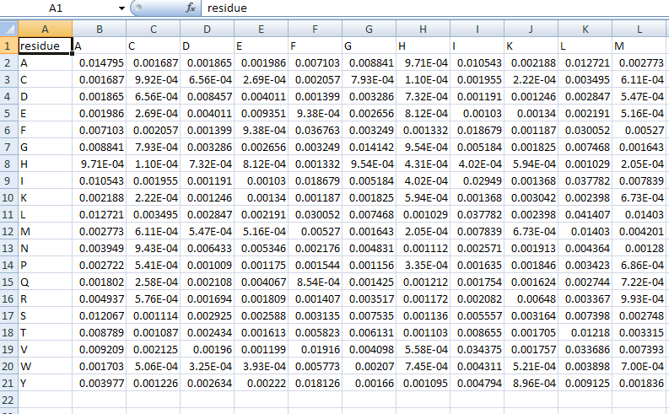
Within the alignment of the first 200 residues, an A to A transition occurred ~1.5% of the time
An estimate of p_{aa}
Assuming sequences in an alignment are
Related, how often does an ala stay an ala?

Slide 16
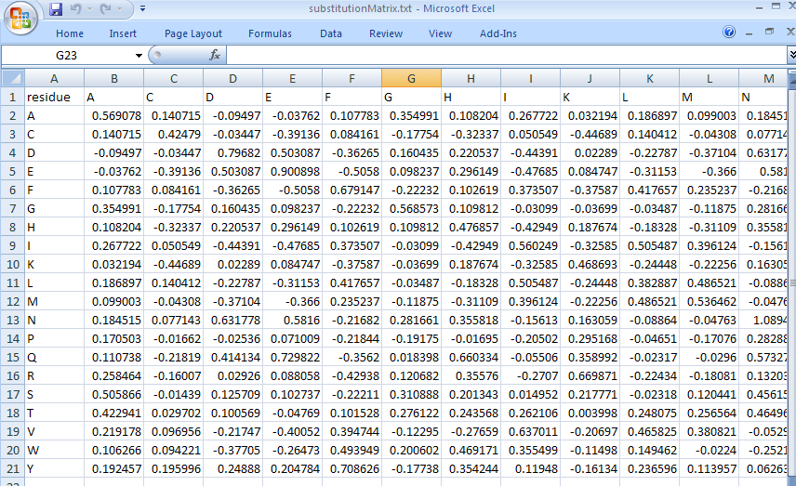
Our pfam derived substitution matrix
Ala is most likely to stay an Ala, but Gly or Ser (similar AAs) or almost as good…
Isoleucine is likely to stay an ILE, but LEU is almost as good (and VAL is a little better!)

Slide 17
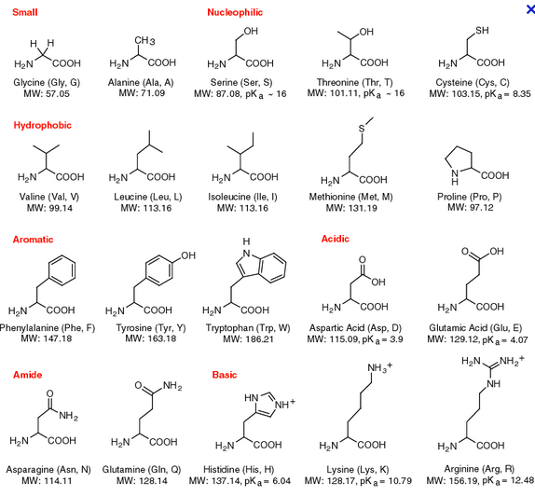
http://www.neb.com/nebecomm/tech_reference/images/amino.gif

Slide 18
How do we compare to an “official” substituion matrix?

Slide 19
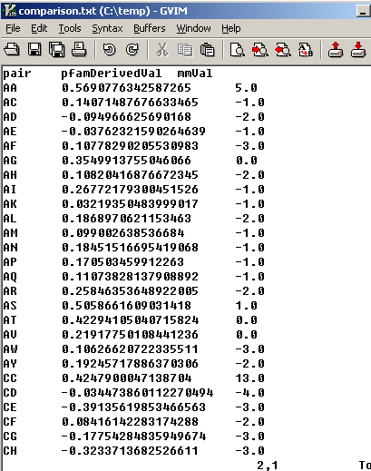
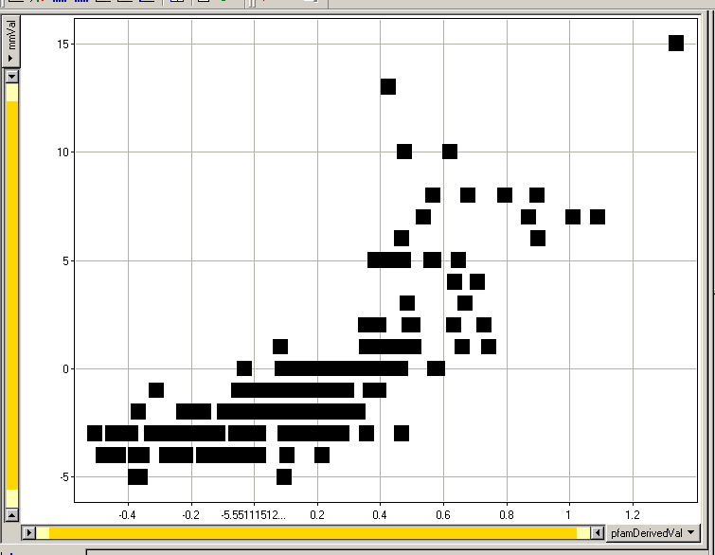
We have broad but imperfect agreement between BLOSSOM 50 and our own
(somewhat sloppily derived!) PFAM substituion matrix.
CC
HH
PP
Blossom Derived
PFAM Derived
In this ion channel pore, HH, CC and PP are observed less often than in the Blossom derived

Slide 20
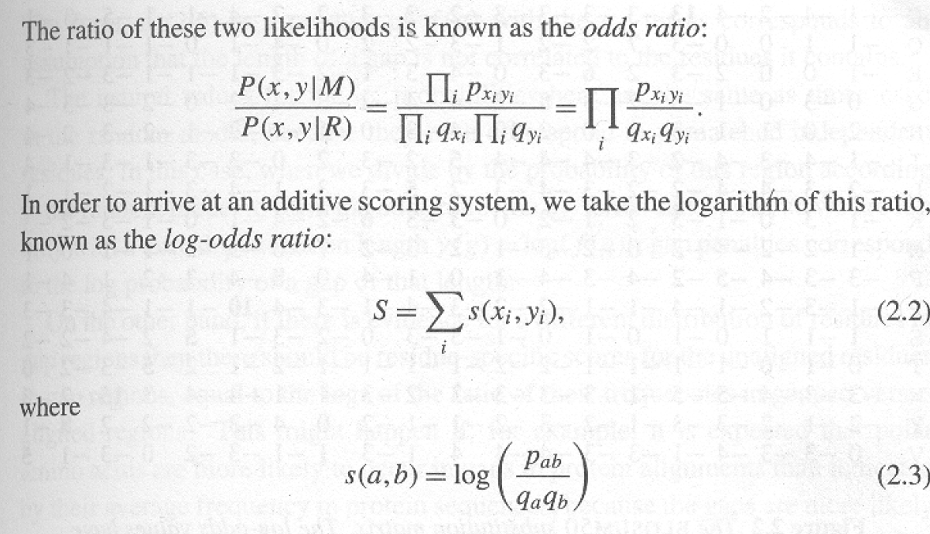
A substitution matrix is just a description of a training set describing what it means to have a match
What you expect from matched residues
What you expect from unmatched residues

Slide 21
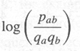
This is the “score” of the alignment…
By working in log space, we avoid overflow errors.
The substitution matrix saves from having to calculate over and over again.
It is integer because integer calculations are more efficient.
(trade a little bit of accuracy for speed and memory)

Slide 22
Therefore most substitution matrices are integers (representing rounded log probabilities)

Slide 23
A key assumption is independence. What happens in one
part of the sequence does not effect another..
This is a terrible assumption for structural RNA…

Slide 24
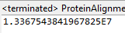
But let’s return to our alignment…
EVLISPISHERE
ELVIRAISHERE
We can think of this odd-ratio as how much more likely is it
that the sequences are related that we would expect by chance?
The odds are 13 million to 1 that we could have seen such a good alignment by chance
(given our “background” model derived from the PFAM alignment)
(But that 13 million to 1 is a little mis-leading…)

Slide 25
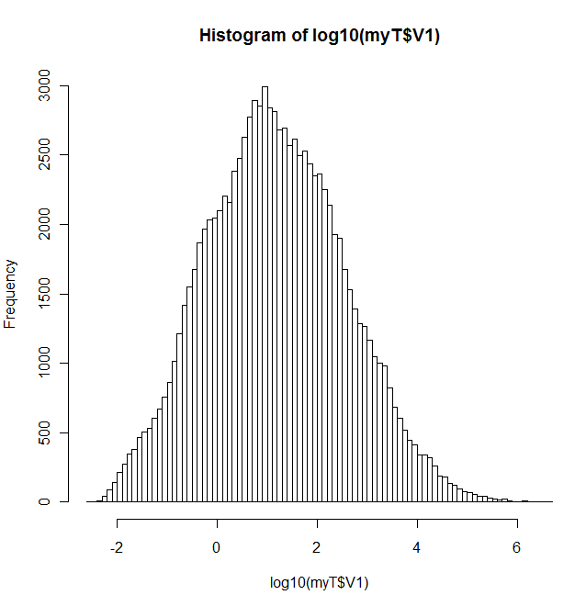
If we (many times) randomly scramble the order of residues in our alignment
Note that this is not centered at zero..
If the assumptions of the training set
are off by even a little, the log-odds ratio
can be biased in one direction or another.
“ELIVSISEVERYWHERE” does not have
the expected background distribution
(so the 13 million to 1 estimate is an
over-estimate of the significance caused by
an inadequately defined training set)

Slide 26
Scoring an alignment with substitution matrices
Generating an alignment with dynamic programming
Local alignments
Makrov Chains

Slide 27
We have our scoring function…
:
Now we want to go the other way, given a scoring function
and two sequences, can we align them to yield the highest
score under the scoring function…

Slide 28
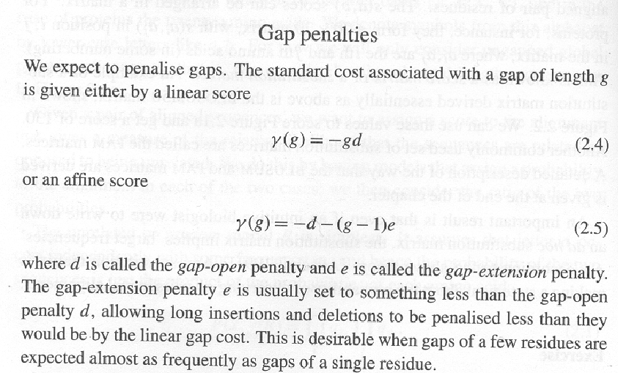
We need to work out a way to score gaps….

Slide 29
Given two sequences and a scoring function
(substitution matrix + gap function), find the best alignment
(highest scoring alignment).
Why not just calculate all the possible alignments?

Slide 30
Why not just calculate all the possible alignments?
N₁N₂ ----- N₃N₄N₅
-- M₁M₂M₃M₄M₅ ---
An alignment is equivalent to…
N₁ N₂M₁ M₂ M₃ M₄ M₅N₃ N₄ N₅
The # of ways of intercalating two sequences of length N and M
(while preserving the order of the symbols) is:
Given two sequences (both of 100 bp) there are
=
90,548,514,656,103,281,165,404,177,077,484,163,874,504,589,675,413,336,841,320
If you could score 1,000 alignments/second, you would still be
Looking at > 10⁴⁵ years…

Slide 31
Dynamic programming…Will guarantee the best score in
time O(M * N) (and memory M *N).
The key assumption… independence..
Calculate the scores of the sub-alignments first…

Slide 32
The big idea.. If we know that for “AWC” and “ATC” that
this is the best alignment…
AWC
ATC
We can “remember” that and use that alignment as the base
for any longer pair of sequences that start the same way.
We don’t have to recalculate that score (or the fact that that is
the best alignment) for every pair of sequences that starts
the same way….
Again, this works because of the assumption of independence.
Nothing we will add later will change the fact that for
“AWC” and “ATC” the above is the best alignment.

Slide 33
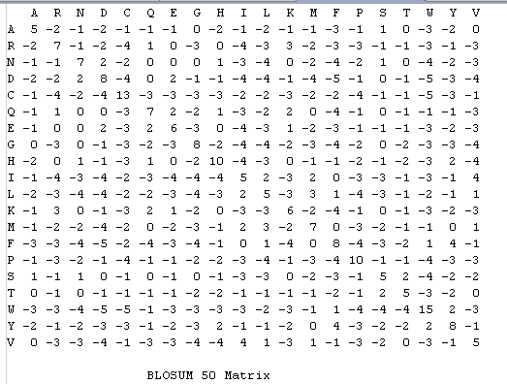
We take the example in the book*…
PAWHEAE
HEAGAWGHEE
Blosom50 matrix;
Constant (linear) gap penalty -8
Durbin et al Biological Sequence Analysis: Probabilistic Models of Proteins and Nucleic Acids

Slide 34
PAWHEAE
HEAGAWGHEE
H E A G A W G H E E
P
A
W
H
E
A
E
When setting this up, put one extra row and one extra column
(as if there is an invisible residue at the start of each sequence)

Slide 35
H E A G A W G H E E
P
A
W
H
E
A
E
Start in the lower right corner.
If there is an “up arrow” emit
-
E

Slide 36
H E A G A W G H E E
P
A
W
H
E
A
E
Start in the lower right corner.
Two “up arrows” emit
- -
E A

Slide 37
H E A G A W G H E E
P
A
W
H
E
A
E
Start in the lower right corner.
If there is a “diagonal arrow” emit
E
E

Slide 38
H E A G A W G H E E
P
A
W
H
E
A
E
Start in the lower right corner.
Two “diagonal arrows” emit
EE
EA

Slide 39
H E A G A W G H E E
P
A
W
H
E
A
E
Start in the lower right corner.
A “right arrow” emits
E
-

Slide 40
H E A G A W G H E E
P
A
W
H
E
A
E
Start in the lower right corner.
Two “right arrows” emits
EE
--

Slide 41
H E A G A W G H E E
Finish
P
A
W
H
E
A
E
Start
We can think of an alignment as choosing the “best” path from
start to finish. There are
alignments
(possible paths) from start to finish.

Slide 42
H E A G A W G H E E
Finish
P
A
W
H
E
A
E
Start
We “traceback” to read the backwards alignment from the path.

Slide 43
H E A G A W G H E E
Finish
P
A
W
H
E
A
E
Start
We “traceback” to read the backwards alignment from the path.
E
E

Slide 44
H E A G A W G H E E
Finish
P
A
W
H
E
A
E
Start
We “traceback” to read the backwards alignment from the path.
EE
EA

Slide 45
H E A G A W G H E E
Finish
P
A
W
H
E
A
E
Start
We “traceback” to read the backwards alignment from the path.
EEH
EAE

Slide 46
H E A G A W G H E E
Finish
P
A
W
H
E
A
E
Start
We “traceback” to read the backwards alignment from the path.
EEHG
EAEH

Slide 47
H E A G A W G H E E
Finish
P
A
W
H
E
A
E
Start
We “traceback” to read the backwards alignment from the path.
EEHGW
EAEH-

Slide 48
H E A G A W G H E E
Finish
P
A
W
H
E
A
E
Start
We “traceback” to read the backwards alignment from the path.
EEHGWA
EAEH-W

Slide 49
H E A G A W G H E E
Finish
P
A
W
H
E
A
E
Start
We “traceback” to read the backwards alignment from the path.
EEHGWAG
EAEH-W-

Slide 50
H E A G A W G H E E
Finish
P
A
W
H
E
A
E
Start
We “traceback” to read the backwards alignment from the path.
EEHGWAGA
EAEH-W-A

Slide 51
H E A G A W G H E E
Finish
P
A
W
H
E
A
E
Start
We “traceback” to read the backwards alignment from the path.
EEHGWAGAE
EAEH-W-A-

Slide 52
H E A G A W G H E E
Finish
P
A
W
H
E
A
E
Start
We “traceback” to read the backwards alignment from the path.
EEHGWAGAEH
EAEH-W-A-P

Slide 53
H E A G A W G H E E
Finish
P
A
W
H
E
A
E
Start
We “traceback” to read the backwards alignment from the path.
This is not a very good alignment!
EEHGWAGAEH
EAEH-W-A-P

Slide 54
How do we find the best alignment?

Slide 55
H E A G A W G H E E
0
P
A
W
H
E
A
E
We start by putting a zero to represent a zero length
alignment having a score of zero.

Slide 56
H E A G A W G H E E
0
-8
-16
-24
-32
-40
-48
-56
-64
-72
-80
P
-8
A
-16
W
-24
H
-32
E
-40
A
-48
E
-56
We can fill out the edges representing sequence aligned to gaps

Slide 57
H E A G A W G H E E
0
P
A
X
W
H
E
A
E
Consider this box: What is the best way to Align “PA” and “”.
Well. There is only way!
--
PA
(score –16)
Moreover, this alignment “builds on” “P” and “” (hence the arrows)

Slide 58
H E A G A W G H E E
0
-8
-16
-24
-32
-40
-48
-56
-64
-72
-80
P
-8
A
-16
W
-24
H
-32
E
-40
A
-48
E
-56
X
The box marked with X represents:
-------
PAWHEAE

Slide 59
H E A G A W G H E E
0
-8
-16
-24
-32
-40
-48
-56
-64
-72
-80
P
-8
-16
A
-16
W
-24
H
-32
E
-40
A
-48
E
-56
Consider this box: What is the best way to align “H” and “P”
One Option:
-H
P-
We’ve already calculated the score of
-
P
So if we take this option the new score is –8 + (-8)

Slide 60
H E A G A W G H E E
0
-8
-16
-24
-32
-40
-48
-56
-64
-72
-80
P
-8
-16
-16
A
-16
W
-24
H
-32
E
-40
A
-48
E
-56
Another option:
H-
-P
We’ve already calculated the score of
H
-
So if we take this option the new score is –8 + (-8)

Slide 61
H E A G A W G H E E
0
-8
-16
-24
-32
-40
-48
-56
-64
-72
-80
P
-2
-8
-16
-16
A
-16
W
-24
H
-32
E
-40
A
-48
E
-56
Another option:
H
P
This score is 0 –2

Slide 62
H E A G A W G H E E
0
-8
-16
-24
-32
-40
-48
-56
-64
-72
-80
P
-8
-2
A
-16
W
-24
H
-32
E
-40
A
-48
E
-56
We take the highest of our three options
And we remember from where the choice came from

Slide 63
H E A G A W G H E E
0
-8
-16
-24
-32
-40
-48
-56
-64
-72
-80
P
-8
-2
A
-16
W
-24
H
-32
E
-40
A
-48
E
-56
We read this as: If we had to align “H” and “P”,
H
P
is better than
H-
-P
or
-H
P-

Slide 64
H E A G A W G H E E
0
-8
-16
-24
-32
-40
-48
-56
-64
-72
-80
P
-8
-2
-10
A
-16
W
-24
H
-32
E
-40
A
-48
E
-56
Another option:
On to the next box. What’s the best way to align
“HE” and “P”
HE
P-
H
P
We’ve already calculated , so the new value
is –2 + (-8)

Slide 65
H E A G A W G H E E
0
-8
-16
-24
-32
-40
-48
-56
-64
-72
-80
P
-24
-8
-2
-10
A
-16
W
-24
H
-32
E
-40
A
-48
E
-56
Another option:
On to the next box. What’s the best way to align
“HE” and “P”
HE-
--P
HE
--
We’ve already calculated , so the new value
is –16 + (-8)

Slide 66
H E A G A W G H E E
0
-8
-16
-24
-32
-40
-48
-56
-64
-72
-80
P
-9
-8
-2
-24
-10
A
-16
W
-24
H
-32
E
-40
A
-48
E
-56
Another option:
On to the next box. What’s the best way to align
“HE” and “P”
HE
-P
H
-
We’ve already calculated , so the new value
is –8 + (-1)

Slide 67
H E A G A W G H E E
0
-8
-16
-24
-32
-40
-48
-56
-64
-72
-80
P
-8
-2
-9
A
-16
W
-24
H
-32
E
-40
A
-48
E
-56
If we have to align “HE” and “P”
So
HE
-P
is better than
HE
P-
HE-
--P
or

Slide 68
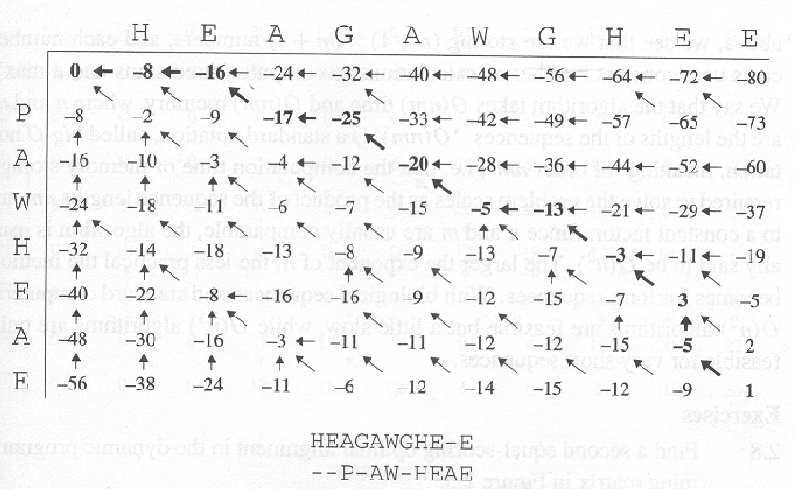
The completed matrix (from the book)

Slide 69
Scoring an alignment with substitution matrices
Generating an alignment with dynamic programming
Local alignments
Multi-threaded dynamic programming

Slide 70
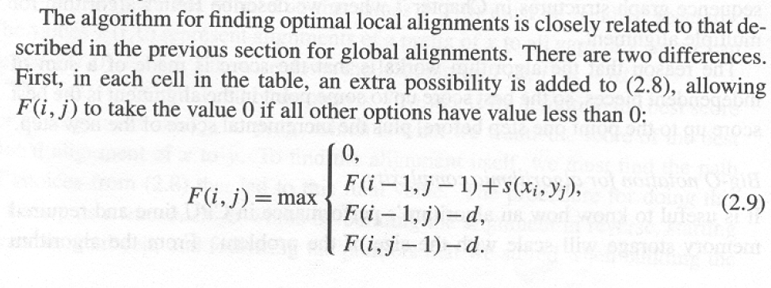
Local alignment is often much more useful than global alignment.
There is usually very little reason to think that 2 sequences will
be related across their entire length….
Local alignment is a pretty trivial modification to global alignment…
Smith-Waterman algorithm….
A favorite algorithm in bioinformatics

Slide 71
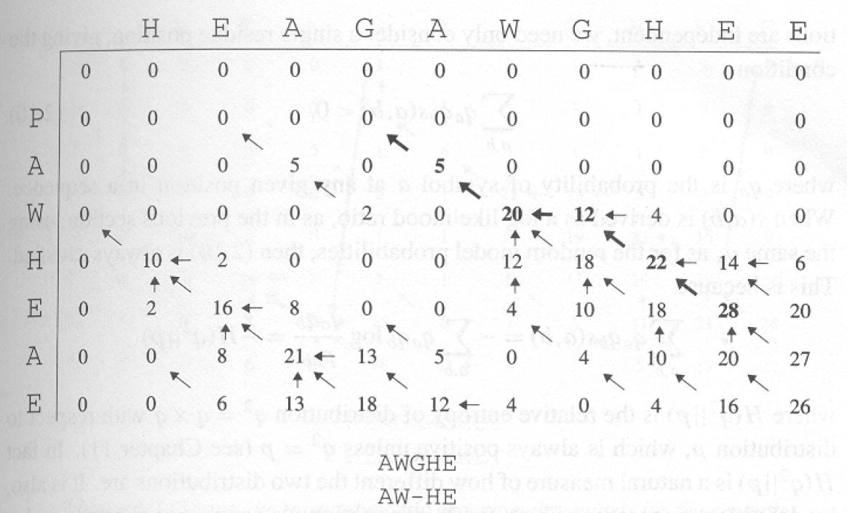
We start with the highest score rather than the lower-right corner.
We end with a 0 rather than the left-hand corner.
Local alignment always is always relative to a threshold…

Slide 72
Smith Waterman is very slow O(N*M)….
If there is a database of X sequences, a search of the database is
O(X*N*M) where N is the query length and M is the average
length of the sequence in the database.
Much too slow to search a database of genomic scale…

Slide 73
Scoring an alignment with substitution matrices
Generating an alignment with dynamic programming
Local alignments
Makrov Chains

Slide 74
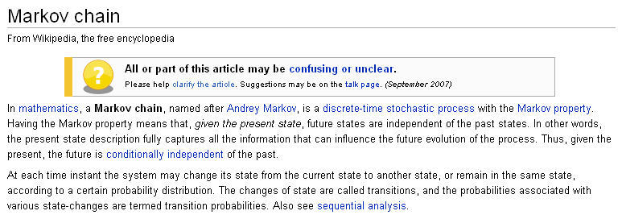
Markov chains have no memory. “Future states are independent
of the past states”.
Markov chains at each time instant can change from one state
to another state (or remain the same) with given probabilities..

Slide 75
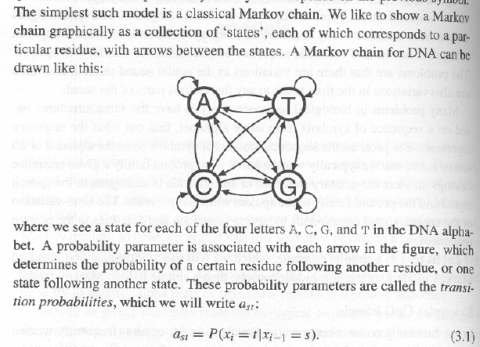
Consider a simple model for DNA dinucleotide frequencies
The probability of moving from state s to t does not
depend on the previous history of where you’ve been.
(No memory)
So if you are in “A”, there is a certain probability of staying in
“A” or moving to “C”, “G” or “T” but that does not depend in this
model on the previous sequence.

Slide 76
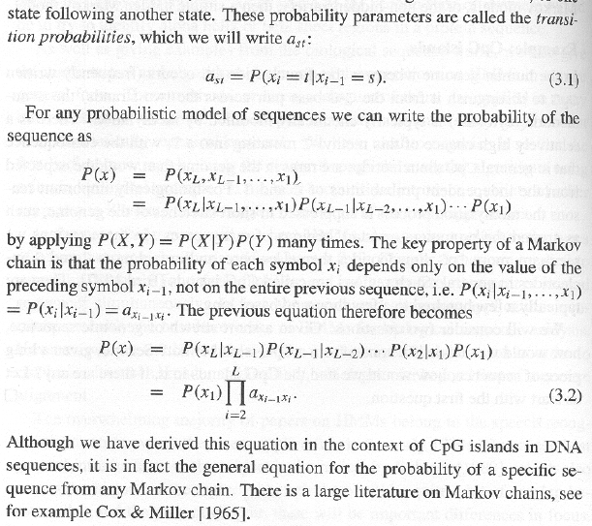
This lack of memory means you can write the probability of
having moved through a particular set of states very easily!
a_{st} is the prob. of
moving from state s to t
P(X) is the probability of traversing all states X₁ to X_{L}
Just the probability of the first state multiplied by every state transition

Slide 77
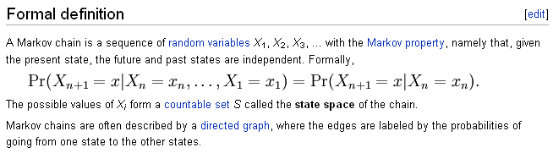
The same math shows up on the Wiki page…

Slide 78
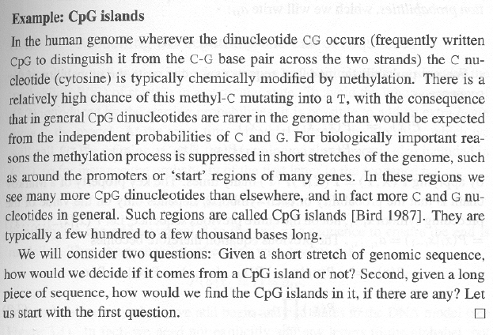
A simple markov chain to score CpG islands…
1
2
CG s can be methylated…
But this methylation is suppressed near active genes…
Question 1 is addressed by Markov chains.
Question 2 is addressed by Hidden Markov Models

Slide 79
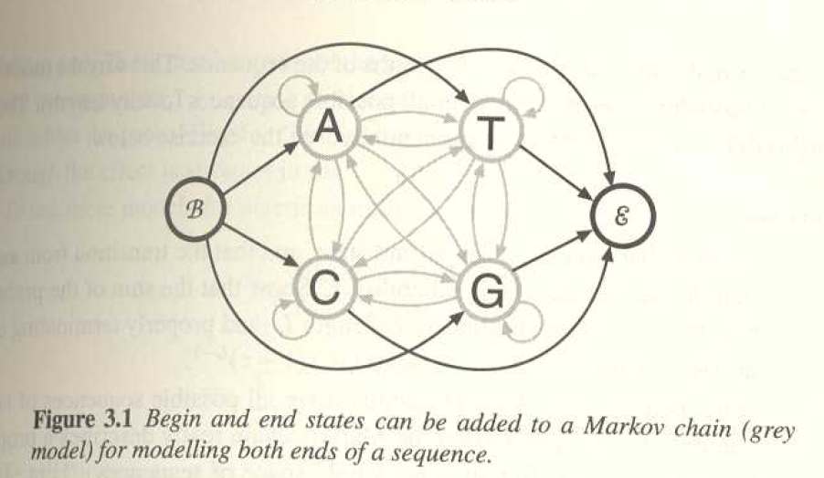
Question 1: Given a short stretch of genomic sequence, how would
we decide if it comes from a CpG island or not?
Here is our model. We have added an explicit begin and end state.
This means that we have some expectation about how long the
sequence that we are looking at will be because there is some
probability with each transition that we will transition to the end
state.

Slide 80
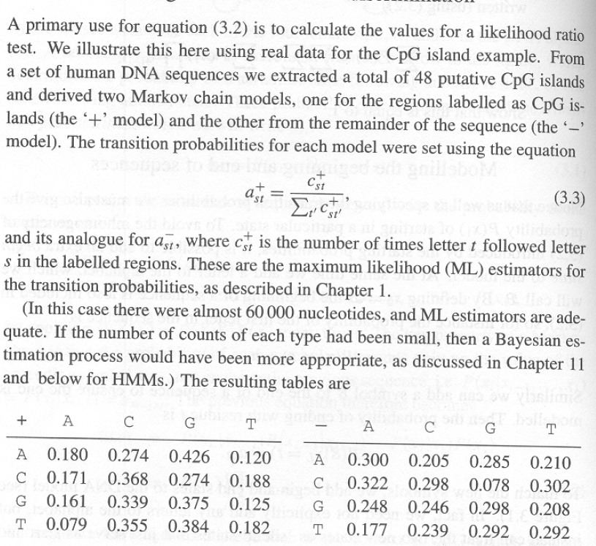
Like almost everything else in this book, we need to define a training
set…
They take 60,000 nucleotides in which 48 CpG islands have been
identified. Then they count the frequency of each dinucleotide.

Slide 81
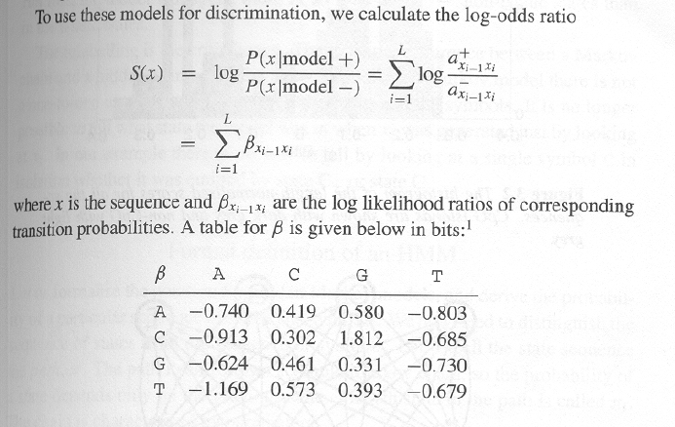
The next part should look pretty familiar from Chapter 2.
We make a “substitution matrix” for our dinucletoide frequencies.
Given a first nucleotide, what is the probability of seeing a second one?

Slide 82
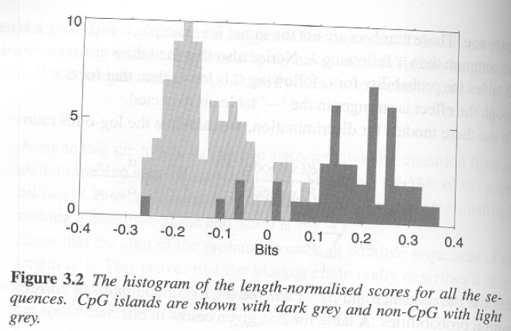
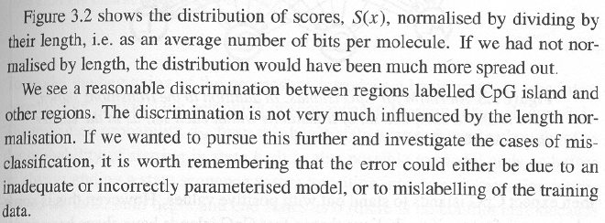
The 16 parameter model does a reasonable job of describing
the data from which it is derived…

Slide 83
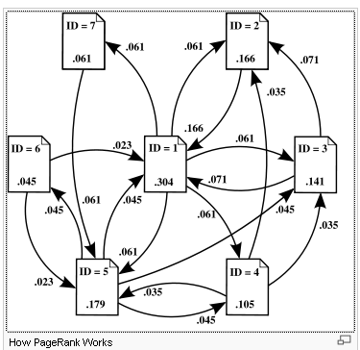
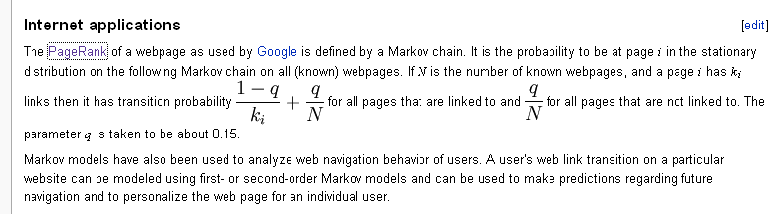
The most lucrative algorithm in history is a Markov chain…
The
The “states” are web pages and
the transitions between them are
the links from web page to web page.
Use the Markov chain to calculate
the probability that a person clicking
on random links would be directed
to a given web page…
Those web pages with many links
by other pages with many links are
ranked higher by Google

Slide 84
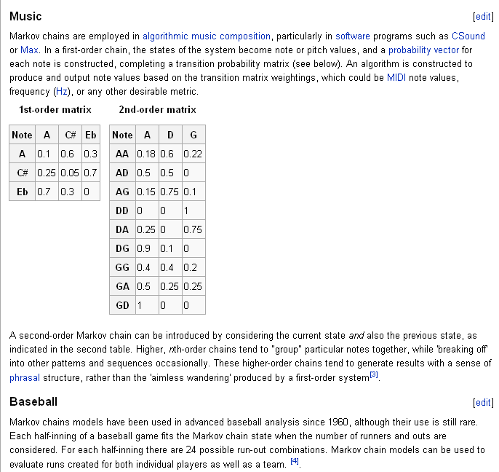
Pretty much anything can be modeled with Markov chains

Slide 85
Next, we want to think about the second question…
Given a long piece of sequence, how would we find the CpG islands
in it, if there are any?
We could take our scoring scheme and apply it to the genome sequence
With a given window size (say 100 base pairs)
A reasonable approach, but there is a potentially more powerful alternative

Slide 86
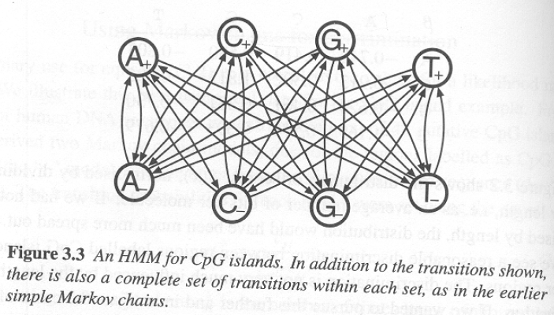
A hidden Markov Model (HMM)
Many parameters (there are 32 parameters not drawn here)…
Given a sequence, we wish to know the states that generated that
sequence.
The states are hidden. We observe symbols. We then infer the states
that are most likely to have emitted the observed symbols.

Slide 87
In this model A+,A- emit A
C+,C- emit C
G+,G- emit G
T+,T- emit T
Given a sequence, the challenge is to find whether we are in
the + or – states.

Slide 88
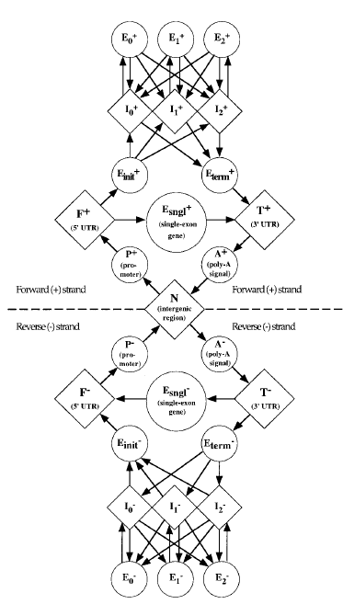
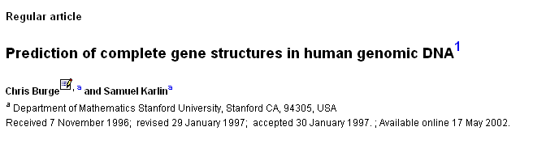
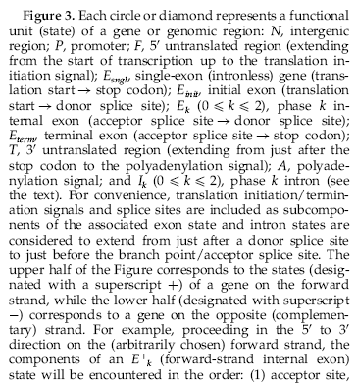
Genscan. A venerable gene prediction algorithm for
predicting genes in genomic DNA. HMM.
(cited ~2,508 times)

Slide 89
In Chapter 3, we’ll learn.
Given a sequence, what is the most probable
annotation of that sequence.
We have some sequence and we would
like to construct a path of states through
some model that is the best
explanation of that sequence.
We are going to apply this with very simple
2 state models.
But the math is the same no matter how
simple or complex the model…

Slide 90
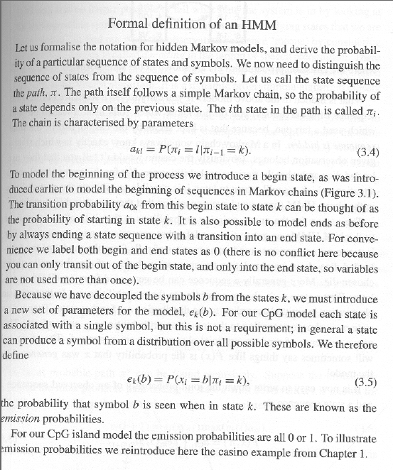
π is the path of states
(usually not known)
a_{kl} is the probability of
Going from state k to l
a₀ is the initial state (and confusingly the same label for a separate end state!)
For symbol b, e_{k}(b) is the prob. that you observe symbol b given that you are in state k

Slide 91
We can now describe this more formally…
In this model A+,A- emit A
C+,C- emit C
G+,G- emit G
T+,T- emit T
For a given nucleotide i in the sequence we observe b
P(b_{i}=A|k_{i}=A+) = 1
P(b_{i}=C|k_{i}=A+) = 0
P(b_{i}=G|k_{i}=A+) = 0
P(b_{i}=A|k_{i}=A-) = 1
P(b_{i}=C|k_{i}=A-) = 0
P(b_{i}=G|k_{i}=A-) = 0
P(b_{i}=T|k_{i}=A+) = 0
P(b_{i}=T|k_{i}=A-) = 0

Slide 92
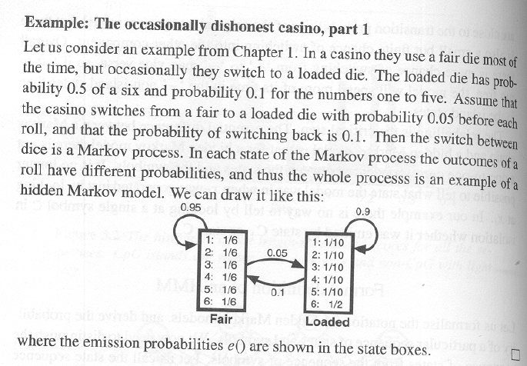
In the GpC HMM each state π_{i} emits only one symbol (A,C,G or T).
To show a more interesting case, they reintroduce the
occasionally dishonest casino…

Slide 93
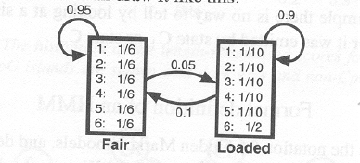
Describing this formally as an HMM…
P(b_{i}=1|k_{i}=fair) = 1/6
P(b_{i}=1|k_{i}=loaded) = 1/10
P(b_{i}=2|k_{i}=fair) = 1/6
P(b_{i}=2|k_{i}=loaded) = 1/10
P(b_{i}=3|k_{i}=fair) = 1/6
P(b_{i}=3|k_{i}=loaded) = 1/10
P(b_{i}=4|k_{i}=fair) = 1/6
P(b_{i}=4k_{i}=loaded) = 1/10
P(b_{i}=5|k_{i}=fair) = 1/6
P(b_{i}=5k_{i}=loaded) = 1/10
P(b_{i}=6|k_{i}=fair) = 1/6
P(b_{i}=6|k_{i}=loaded) = 5/10

Slide 94
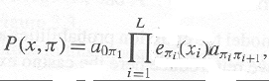
Assuming we start in State1..
What’s the probability of rolling a 1 and a 3 with the
fair die and then a 6 with the loaded die?
(1)(1/6) *
(0.95)(1/6) * (0.05) * (.5)
We start
in the fair state
We roll a
1 in the fair state
We stay
in the fair
state
We roll a
3 in
the fair state
We move
To the
loaded
state
We roll a
6 in
the loaded state
The joint prob. of
the traversal of the state-path
and the emissions
transition prob.
of moving from
state π_{i-1} to π_{i}
Emission prob.
of observing x from
State π_{i}
prob. of starting in the initial state

Slide 95
This is not that useful because we generally don’t know π
(the path through the states).
Much more useful is the most probable path, given the observed
sequence…

Slide 96
We have the sequence. If we know the
most probable path through the Genbank
HMM, we have our gene predictions
for that sequence..

Slide 97
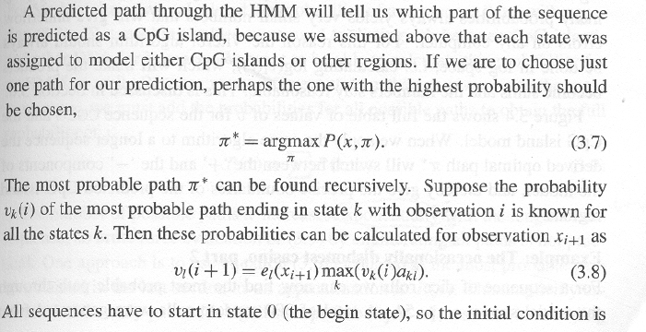
A beautiful recursive algorithm…
π* the most probable path through the system of all the possible paths
(i.e. of all possible π)
v_{k}(i) is the probability of the most probable path ending in state k with observation i

Slide 98
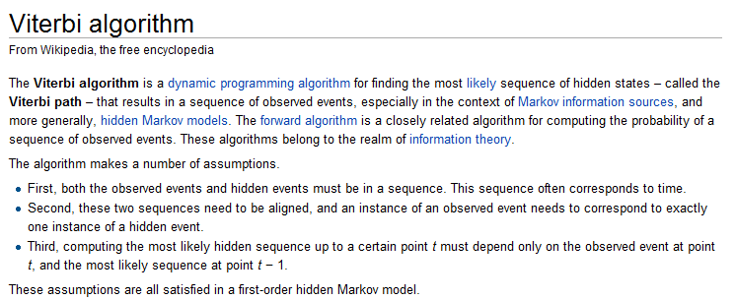
http://en.wikipedia.org/wiki/Viterbi_algorithm

Slide 99
For next time: the viterbi, forward and backwards algorithms

